Slide 1
Infosys ElectViz – Election Data Visualization for Media
Team D
Busetty Sugnesh
Shruti Bore
Jaavanika L

Slide 2
Abstract
Infosys ElectViz is an election data visualization platform developed to present the 2024 Indian General Election results in a clear and media-focused format. It integrates constituency-level voting data with party, alliance, and state-wise results into a unified analytical model. Using structured data modeling and DAX calculations, the platform generates key insights such as alliance dominance, seat distribution, and candidate performance. The interactive dashboards enable seamless navigation from national overviews to detailed constituency analysis for effective election storytelling.
1. Enables multi-level election analysis from national overview to constituency-level details through interactive dashboards.
2. Applies advanced DAX logic to accurately compute alliance classification, winning candidates, vote shares, and rankings.
3. Designed specifically for media and analytical use cases, ensuring fast interpretation, clarity, and data-driven election narratives.

Slide 3
Background & Motivation
1. Indian General Election data is highly complex and multi-dimensional, making traditional tabular analysis slow and difficult to interpret.
2. Media and analytical users require fast, accurate, and visually intuitive insights to support real-time election reporting and analysis.
3. Infosys ElectViz is motivated by the need to simplify complex election data through interactive dashboards that enhance clarity, speed, and data-driven storytelling.

Slide 4
Dataset Overview
The Infosys ElectViz project uses multiple structured datasets sourced from the 2024 Indian General Election results. These datasets together capture voting details at constituency, state, party, and alliance levels, enabling comprehensive election analysis and visualization.
1. ConstituencyWiseDetails.csv
This dataset contains detailed voting information for each candidate contesting in a constituency. Key Columns include: Constituency ID, Constituency Name, Candidate Name, Party, EVM Votes, Postal Votes, Total Votes, and Vote Share (%).

Slide 5
Dataset Overview
2. ConstituencyWiseResults.csv
This dataset captures the final outcome of each constituency. Key Columns include: Constituency ID, Constituency Name, State, Winning Candidate, Winning Party, and Winning Margin.
3. PartyWiseResults.csv
This dataset provides party-level performance across constituencies. Key Columns include: Party Name, Seats Won, and Alliance (derived using DAX logic).

Slide 6
Dataset Overview
4. StatewiseResults.csv
This dataset summarizes election outcomes at the state level. Key Columns include: State Name, Total Seats, Seats Won by NDA, Seats Won by I.N.D.I.A, and Majority Alliance.
5. States.csv
This is a master reference dataset used for standardization and mapping. Key Columns include: State Code and State Name.

Slide 7
Data Modeling & Architecture
Model Structure
The Infosys ElectViz project follows a star schema–based analytical model, where detailed election data is stored in central fact tables and supporting reference information is maintained in dimension tables. All tables are connected using unique identifiers such as Constituency ID, Party ID, and State ID to ensure accurate filtering and aggregation across dashboards.
Why This Structure Is Used
This structure is used to improve performance, simplicity, and scalability in Power BI. Separating transactional data from descriptive data reduces redundancy, simplifies DAX calculations, and enables faster cross-filtering and drill-down analysis across national, state, and constituency levels.

Slide 8
Data Modeling & Architecture
Fact Tables
Fact tables store the core election metrics required for analysis.
ConstituencyWiseDetails contains candidate-level voting data including EVM votes, postal votes, total votes, and vote share, forming the base for candidate comparison and ranking.
ConstituencyWiseResults stores final constituency outcomes such as winning candidate, winning party, and margin, supporting seat aggregation and result analysis
Dimension Tables
Dimension tables provide contextual information used for filtering and grouping.
PartyWiseResults maps political parties to their respective alliances, enabling alliance-wise analysis.
States contains standardized state identifiers and names, supporting state-level filtering and geographic visualization.

Slide 9
DAX Measures & Business Logic
Purpose of DAX in the Project
DAX (Data Analysis Expressions) is used in Infosys ElectViz to derive dynamic insights that are not directly available in the raw datasets. Since election analysis requires calculations such as winning candidates, alliance classification, vote share percentages, and ranking of candidates, DAX plays a critical role in transforming stored data into meaningful analytical outputs.
(There are like 15 dax formulas used but only important formulas are shown here)

Slide 10
DAX Measures & Business Logic
1. Selected State Name =
CALCULATE(
SELECTEDVALUE(states[State], "No State Selected"),
FILTER(
ConstituencyWiseResults,
ConstituencyWiseResults[Constituency ID] = MAX(ConstituencyWiseDetails[Constituency ID])
)
)
2. Winning Candidate =
VAR MaxVotes = MAX('ConstituencyWiseDetails'[Total Votes])
RETURN
CALCULATE(
MAX('ConstituencyWiseDetails'[Candidate]),
'ConstituencyWiseDetails'[Total Votes] = MaxVotes
)

Slide 11
DAX Measures & Business Logic
3. Winning Party Name =
VAR MaxVotes = MAX('ConstituencyWiseDetails'[Total Votes])
RETURN
CALCULATE(
MAX('ConstituencyWiseDetails'[Party]),
'ConstituencyWiseDetails'[Total Votes] = MaxVotes
)
4. Winning Candidate Total Votes =
"Total Votes:" & " " & MAX('ConstituencyWiseDetails'[Total Votes])
5. Winning Candidate Vote Share % =
"Vote Share:" & " " & MAX('ConstituencyWiseDetails'[% of Votes]) & " %"

Slide 12
DAX Measures & Business Logic
6. Runner Up Winning Candidate =
VAR MaxVotes = MAX('ConstituencyWiseDetails'[Total Votes])
VAR SecondMaxVotes =
MAXX(
FILTER(
'ConstituencyWiseDetails',
'ConstituencyWiseDetails'[Total Votes] < MaxVotes
),
'ConstituencyWiseDetails'[Total Votes]
)
RETURN
CALCULATE(
MAX('ConstituencyWiseDetails'[Candidate]),
'ConstituencyWiseDetails'[Total Votes] = SecondMaxVotes
)

Slide 13
Dashbaords
Overview Analysis Dashboard
Provides a national-level summary of the 2024 Indian General Election results across all 543 Lok Sabha seats.
Displays alliance-wise seat distribution for NDA, I.N.D.I.A, and Other/Independent parties along with their percentage share of total seats.
Highlights the overall winning alliance and balance of power in Parliament at a glance.
Shows alliance composition by listing the number of parties and individual party seat contributions within each alliance.
Acts as the starting point for analysis before drilling down into state-level and constituency-level insights.

Slide 14
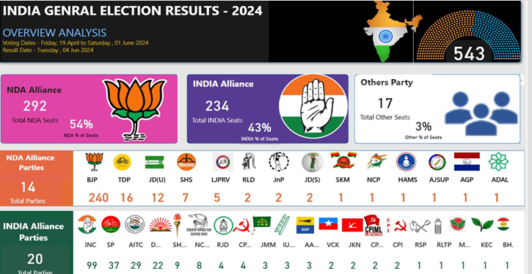

Slide 15
Dashbaords
State Demographics Analysis Dashboard
Visualizes state-wise distribution of total Lok Sabha seats along with NDA and I.N.D.I.A seat counts for each state.
Highlights the alliance holding majority seats in each state using color-coded geographic maps.
Displays constituency-level winning candidate and party information through an interactive map with hover details.
Identifies states where either the NDA or I.N.D.I.A alliance has secured the maximum number of seats.
Enables users to select a state and drill down into detailed constituency-level insights dynamically.

Slide 16
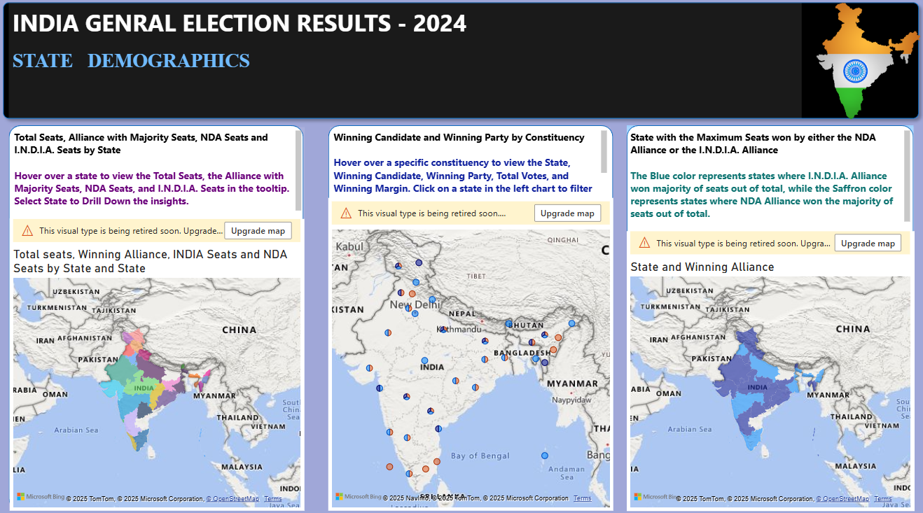

Slide 17
Dashbaords
Constituency Analysis Dashboard
Provides a detailed analysis of a selected constituency by displaying total votes, EVM votes, postal votes, and the number of candidates contesting.
Highlights the winning candidate along with party affiliation, total votes secured, and vote share percentage.
Displays the runner-up and second runner-up candidates to clearly show electoral competition within the constituency.
Enables constituency selection through a slicer, dynamically updating all metrics and candidate details.
Helps compare candidate performance and vote margins at a granular constituency level.

Slide 18
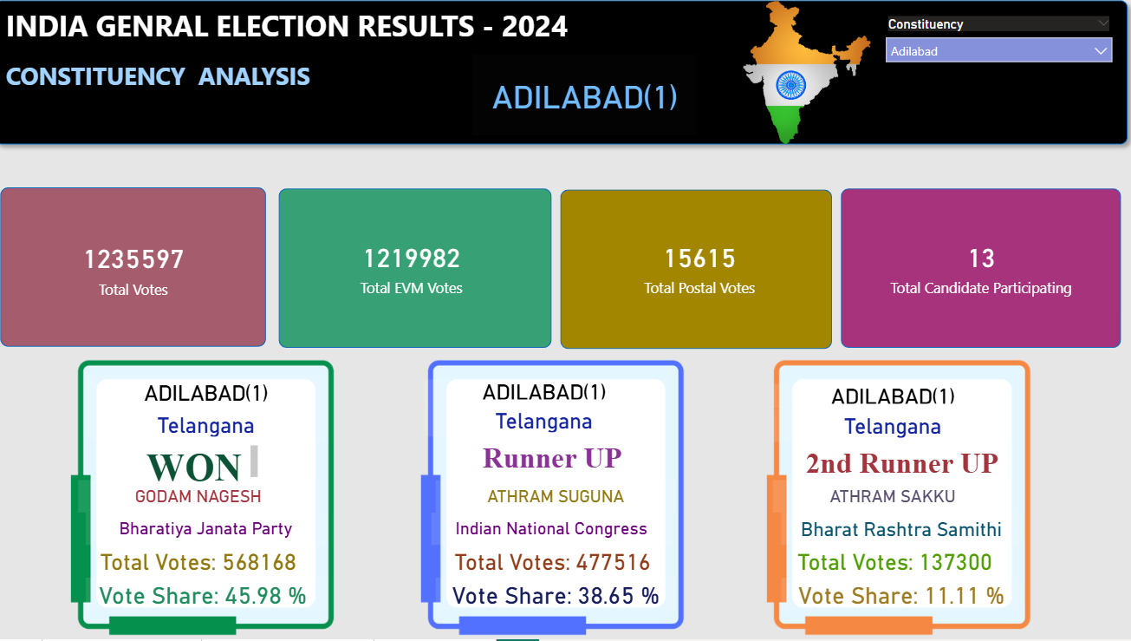

Slide 19
Dashbaords
State Analysis Dashboard
Provides a focused analysis of a selected state by displaying alliance-wise seat distribution for that state.
Highlights the dominance of alliances (NDA and Others) using KPI cards to show total seats won.
Presents party-wise results within the state, showing each party’s alliance affiliation and seats won.
Uses a donut chart to visually represent party-wise seat share, making comparison easy and intuitive.
Enables state selection through a slicer, dynamically updating all visuals for comparative state analysis.

Slide 20
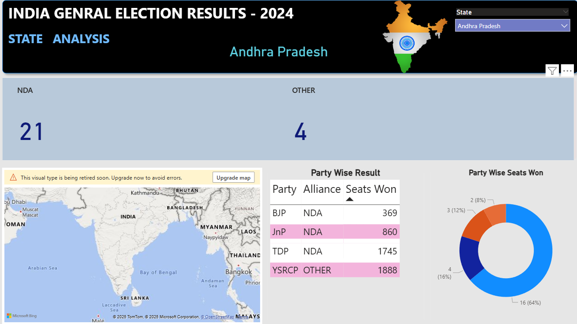

Slide 21
Conclusion and Future Scope
Conclusion
Infosys ElectViz successfully transforms complex 2024 Indian General Election data into clear, interactive, and media-friendly dashboards.
The project enables multi-level analysis by integrating constituency, state, party, and alliance data into a unified analytical model.
Advanced data modeling and DAX calculations ensure accurate insights such as alliance dominance, seat distribution, and candidate performance.
The dashboards support fast interpretation and effective election storytelling for media and analytical users.
Future Scope
Extend the platform to include historical election data for trend and comparative analysis across multiple election years.
Integrate real-time or near real-time data feeds to support live election result tracking.
Apply predictive analytics and AI models to forecast election outcomes and voter behavior patterns.
Enhance demographic analysis by incorporating voter age, gender, and regional socio-economic data.
Deploy the solution as a web-based or cloud-hosted analytics platform for wider accessibility.

